Slide 1
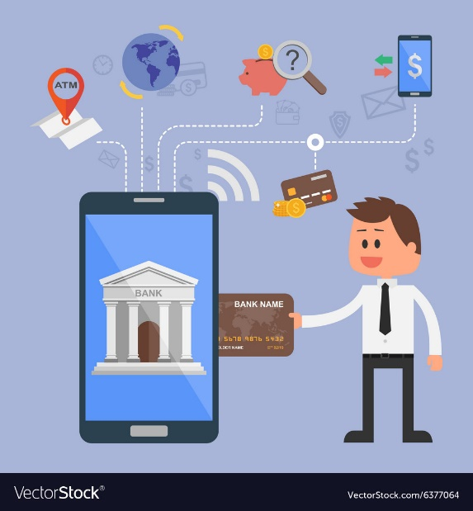
SOFTWARE ARCHITECTURE ASSIGNMENT
Internet Banking (e-Banking) System
Submitted By:- Deepak Jain
Student ID : 2021MT12286 2021MT12286@wilp.bits-pilani.ac.in

Slide 2
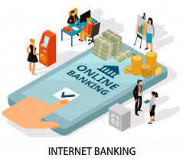
PURPOSE OF THE SYSTEM
Internet banking has made it easy to carry out the personal or business financial transaction without going to bank and at any suitable time.
This facility enables to transfer money to other accounts and checking balance alongside the status of any financial transaction made in the account.
Maintain privacy and to avoid any misuse of transactions, it is necessary to follow a secured architecture model which ensures the privacy and integrity of the transactions and provides confidence on internet banking is stable.
A customer needs a device, an Internet connection and a bank card to register. Once registered, the consumer sets up a password to begin using the service.

Slide 3

PURPOSE OF THE SYSTEM
Consumers aren't required to visit a bank branch in order to complete most of their basic banking transactions.
Enable or disable Usage of online payment of debit card.
Request for new card.
Enable or disable tap and pay facility.
Monitor the transactions and can check the Expenses.
Raise fraud in transaction or stolen card.

Slide 4

KEY REQUIREMENTS - FUNCTIONAL REQUIREMENTS
Functional Requirements for this System will be :-
Security : Hyperelliptic curve cryptosystem is used to perform the encryption and decryption processes in an efficient way merely with an 80-bit key size
Accuracy : System should accurately determine the eligibility of the user in getting the credit card.
Interface Requirements : User onboarding process should take the required information such as, user’s name, pan card number, address, currently working company and location. Post onboarding the user should be able to login with Customer ID and the password provided by the bank.

Slide 5
KEY REQUIREMENTS – NON FUNCTIONAL REQUIREMENTS
Non Functional Requirements for this System will be :-
Performance : Banking system should be able to handle all of its customer traffic on their system and be able provide good customer experience.
Reliability : System should be operational 24x7 the time.
Flexibility : According to new Internet Banking industry requirements the System should be flexible for adding new features.
Maintainability : System should be capable to store and maintain large data of users securely.

Slide 6
UTILITY TREE - TABULAR FORM
Quality Attribute | Attribute Refinement | ASR
Security | Confideniality Integrity | User data must be protected against access by hackers. User’s data stored should confidential. Critical system resources are protected against malicious tampering.
Availability | No downtime Monitoring and Protection | The system should be up 24/7. Illegitimate network connections and use of local resources are not allowed.
Maintainability | Bug Fixes | Routine Bug Fixes to be done, for better user experience.
Configurability | User Onboarding Form Changes | The form used to onboard the user to the platform should be configurable.
Usability | Facility of use | The system should be intuitive and easy to learn, users should be able to use the system without the need of training.
Modifiability | Adding new feature | New features, should be added in order to provide the complete service, according to the industry standards.
Portability | Content Migration | The content of the system is migrated to mobile platforms: smartphones and tablets.
Performance | Response Time of app pages Loading time | Response time for loading any of the pages, in both onboarding and post onboarding should be less. The system homepage should be fully loaded in a maximum of 10 seconds in any operating conditions.

Slide 7
TACTICS TO ACHIEVE TOP 5 ASR
24×7 Availability. Internet banking, unlike usual banking hours, is not time-bound. It is available 24×7 throughout the year. Most of the services available online are not time-restricted. Users can check their bank balance, account statements and make fund transfers anytime instantly.
Convenience of initiating financial transactions. Internet banking is largely preferred because of the convenience that it provides while fund transfer and bill payments. Registered users can use almost all the banking services without having to visit the bank and standing in queues. Financial transactions such as paying bills and transferring funds between accounts can easily be performed anytime as per the convenience of the user.
Proper Track of Transactions. Acknowledgement slips are provided by the bank after transactions which have a high possibility of getting misplaced. However, with internet banking, it becomes very easy to track the history of all the transactions initiated by the user. Transactions and fund transfers made online are organised in the ‘Transaction History’ section along with other details such as payee’s name, bank account number, the amount paid, the date and time of payment, and remarks.

Slide 8
TACTICS TO ACHIEVE TOP 5 ASR
Quick and Secure. Net banking users can transfer funds between accounts instantly, especially if the two accounts are held at the same bank. Funds can be transferred via NEFT, RTGS or IMPS as per the user’s convenience. One can also make bill payments, EMI payments, loan and tax payments easily. Moreover, the transactions, as well as the account, are secured with a password and unique User-ID.
Non-financial Transactions. Besides fund transfer, internet banking allows the users to avail non-financial services such as balance check, account statement check, application for issuance of cheque book, etc.

Slide 9
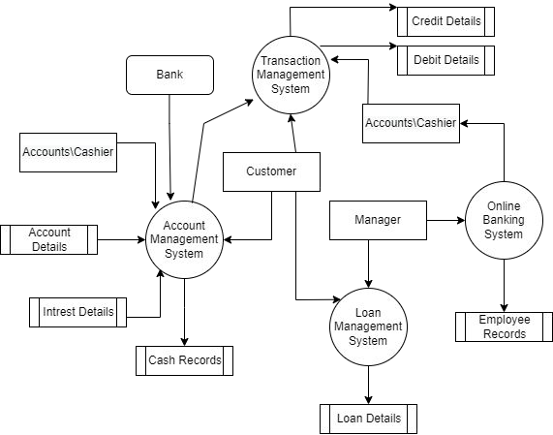
SOFTWARE ARCHITECTURE DIAGRAM
1. Context Diagram

Slide 10
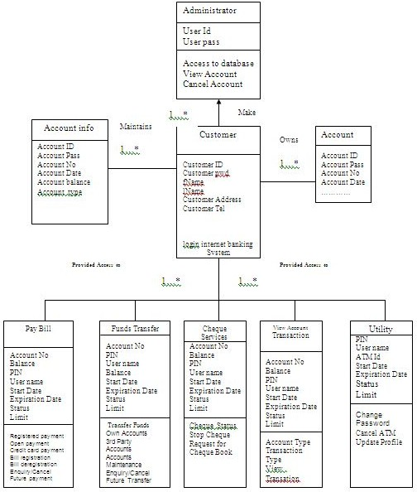
SOFTWARE ARCHITECTURE DIAGRAM
2. Module Decomposition Diagram

Slide 11
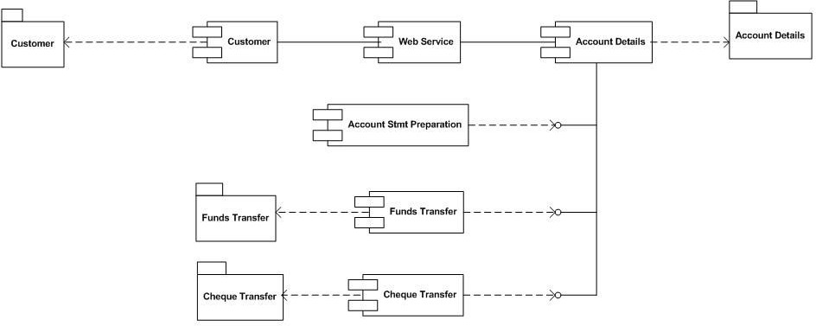
SOFTWARE ARCHITECTURE DIAGRAM
3. Component and Connection Diagram

Slide 12
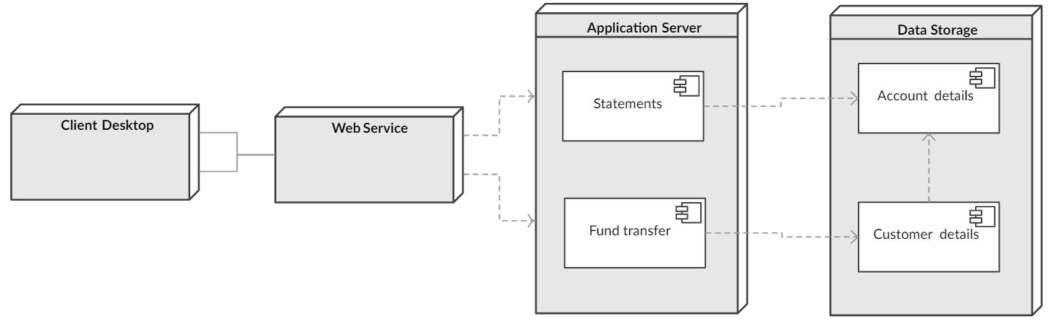
SOFTWARE ARCHITECTURE DIAGRAM
4. Deployment Diagram

Slide 13
SYSTEM DESCRIPTION
Online banking allows a user to conduct financial transactions via the Internet.
Consumers aren't required to visit a bank branch in order to complete most of their basic banking transactions.
A customer needs a device, an Internet connection, and a bank card to register. Once registered, the consumer sets up a password to begin using the service.
Protected with unique ID and password.
Facility to check bank balance any time.
Provides access to financial as well as non-financial banking services.
Keep a check on mortgages, loans, savings a/c linked to the bank account.
Keep a check on investments linked to the bank account.
Set-up or cancel automatic recurring payments and standing orders.
Customers can apply for the issuance of a chequebook.
Make bill payments and fund transfer to other accounts.
Safe and secure mode of banking.

Slide 14
KEY LEARNINGS
Creates a solid foundation for the software project and makes your platform scalable.
Increases the performance of the platform, reduces costs, and avoids code duplicity.
Helps you in implementing a vision.
Helps an organization analyze leading to to cost savings.
Allows for better code maintainability.
Easier to maintain existing software as the structure of the code is visible and known. It makes us for easier debugging and anomalies.
Increases the quality of the platform, helps manage complexity and makes the platform faster.
New technical features approach in case of amendments.
Helps in risk management, reduces its time to market and reduces development time.
Extremely important and play vital role in the Software Development Life Cycle.

Slide 15
THANK YOU

